Slide 1

The Willows Primary School
Information about Reception

Slide 2
Welcome to Reception at The Willows Primary School
Our Reception unit is a friendly, happy and caring place which provides a stimulating and inspiring learning environment for all children. We encourage children to be considerate of the needs of others and they are taught how to look after their friends and our property. We want children to be an important part of the school community and to gain a sense of responsibility and security.
We strive to work in partnership with parents, recognising the joint responsibilty of home and school in a child’s education. Our aim is to build upon the experiences provided by you as parents so that we can work together towards the successful development of your child. Prior to your child starting at The Willows we will arrange a meeting to discuss your child’s learning and development. This provides an excellent opportunity to build relationships and ensures the transition from home to school is positive for every child. It also gives you the chance to learn more about our activities and routines and it allows time to answer any questions you may have.
We have two Reception classes with an intake of 30 children per class.

Slide 3
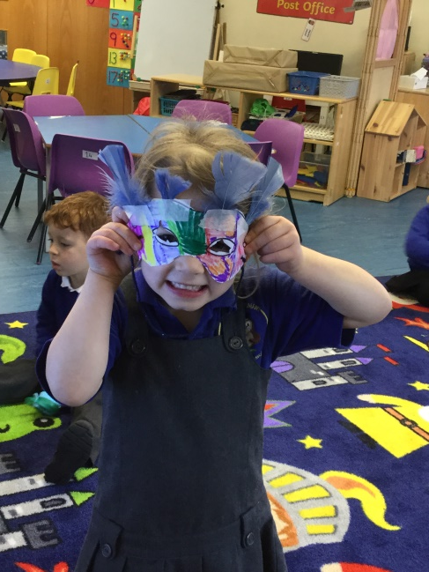
Learning in Reception
We follow The Foundation curriculum which is based on the understanding that children learn through play. The curriculum aims to enrich the development of each child. It encourages the child to be independent and fosters their natural curiosity through exploration and investigation. In our Reception unit, as well introducing the children to a range of topics, we encourage children to follow their own interests and provide an environment that faciliates children to develop their knowledge and understanding of topics which are of interest to them. Children are supported by the environment and the adults who work with them in Reception to learn through playing, exploring, creating and thinking critically.

Slide 4
The learning environment
In each area of the Reception unit the children are able to access activities that will support their learning and development across all areas of the Foundation Stage curriculum.
The learning environment contains a mixture of continuous and enhanced provision. The continuous provision is what the children always have access to and changes over the year to ensure the environment appropriately challenges children’s learning. The enhanced provision are activities which have been specifically planned to develop a key skill, support an area of learning or develop knowledge and understanding of the topic that the children are learning about.

Slide 5
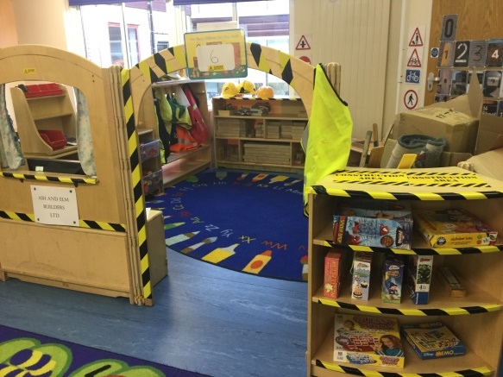
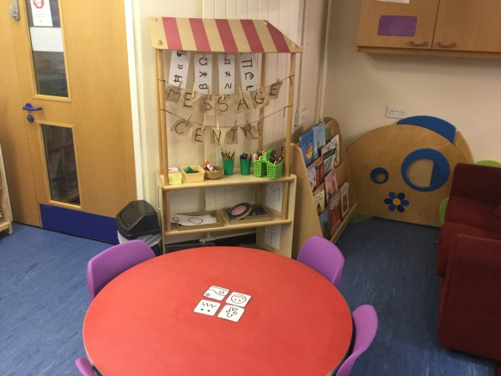
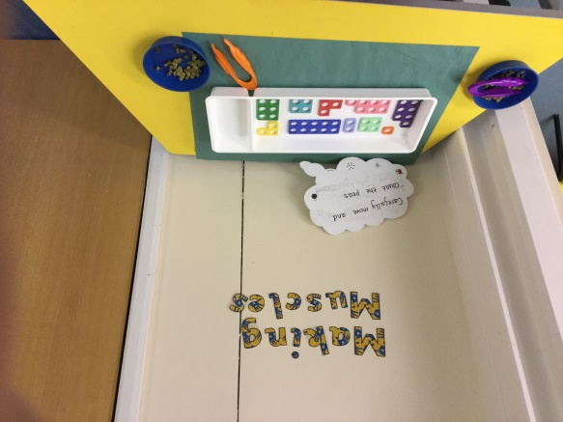
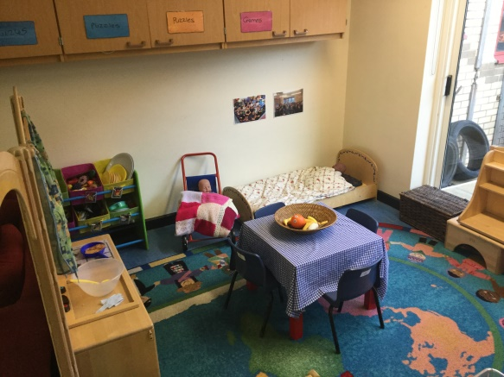
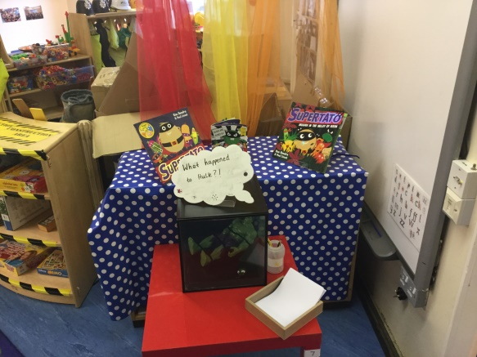
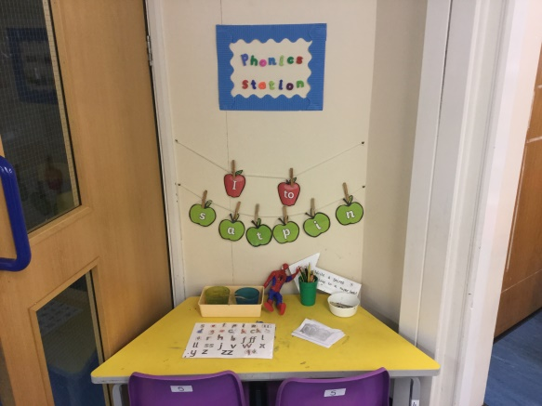
The learning environment – The imagination area
Construction role play
Secret messaging centre to encourage mark making and writing
Making muscles station to develop fine and gross motor control
Home role play area
Curiosity cube to encourage the children to develop their communication skills
Phonics station for children to practise skills taught during adult directed sessions

Slide 6
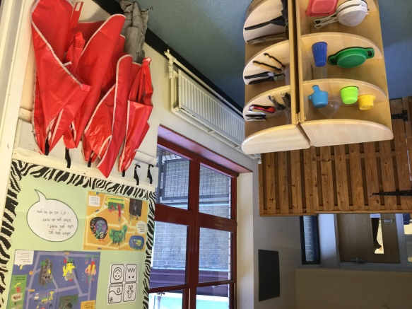
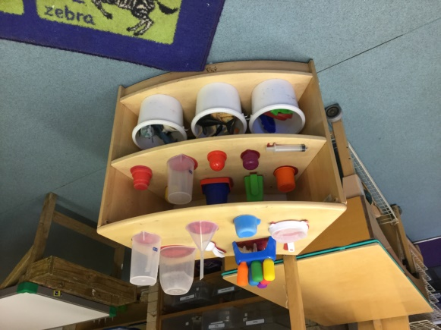
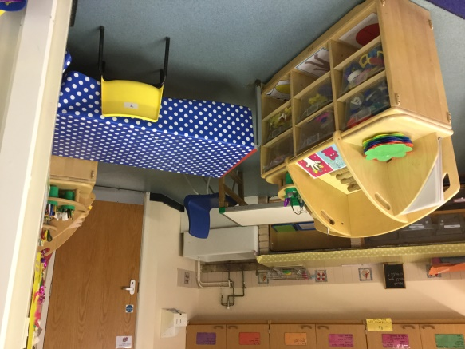
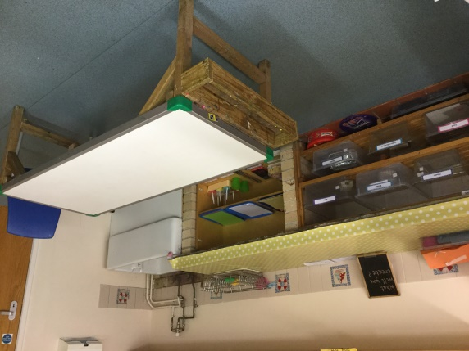
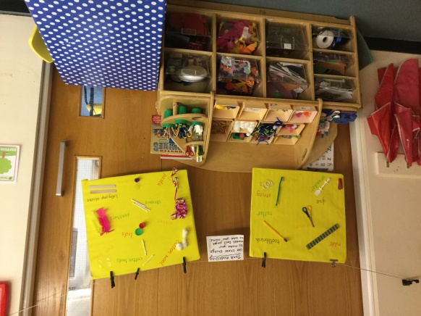
The learning environment – The creative area
Sand play
Water play
Dough gym
Space for children to focus on their own creations
Creative resources for children to self-access

Slide 7
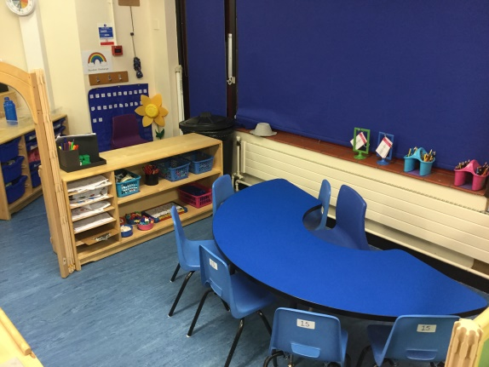
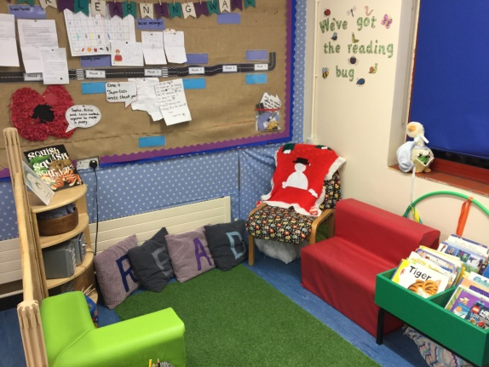
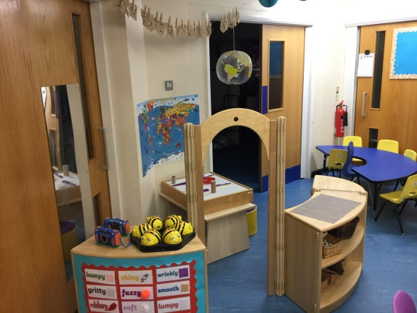
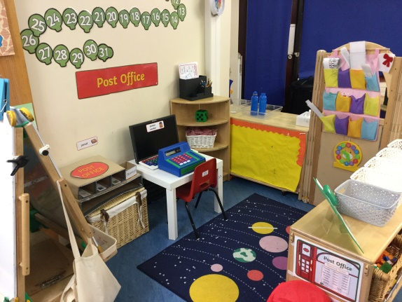
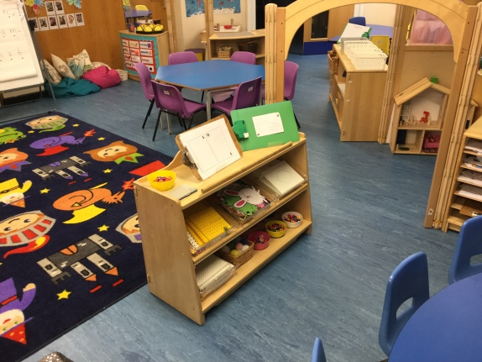
The learning environment – Ash class
Mark making/writing area
Reading area
Investigation station
Maths role play area
Fine motor area

Slide 8
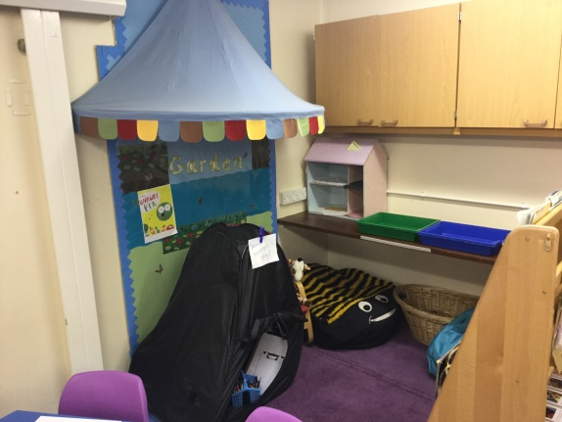
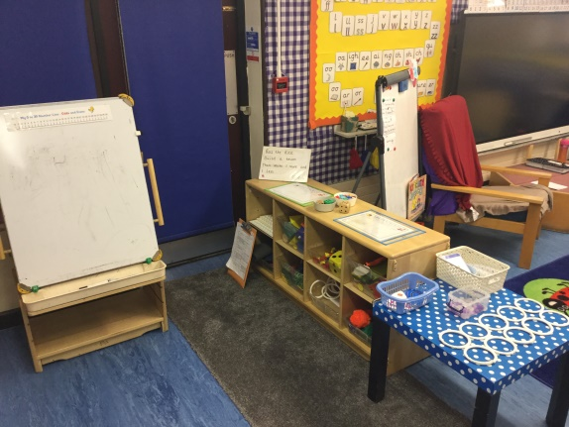
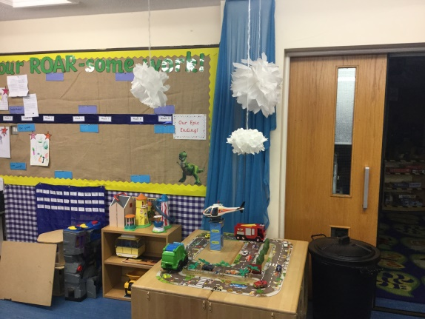
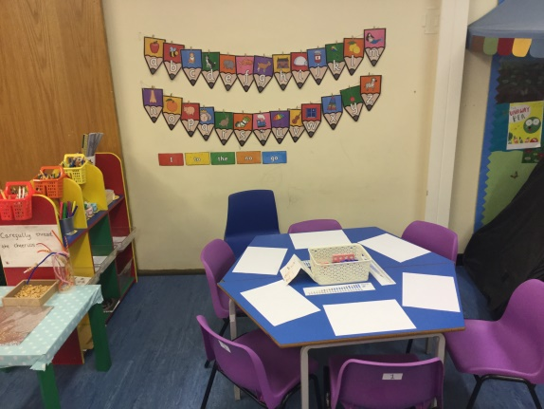
The learning environment – Elm class
Reading area
Maths role play area
Small world play
Mark making/writing area

Slide 9
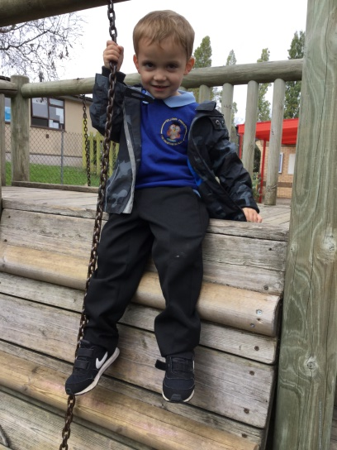
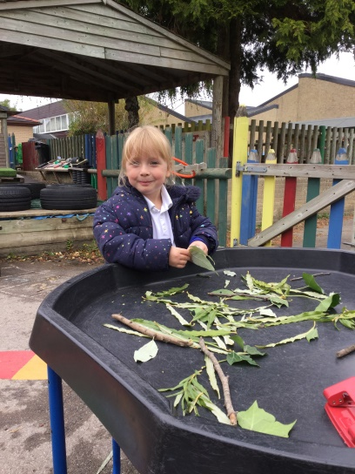
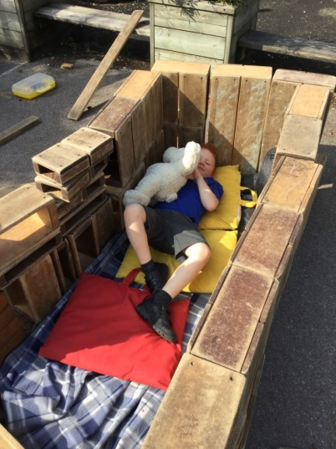
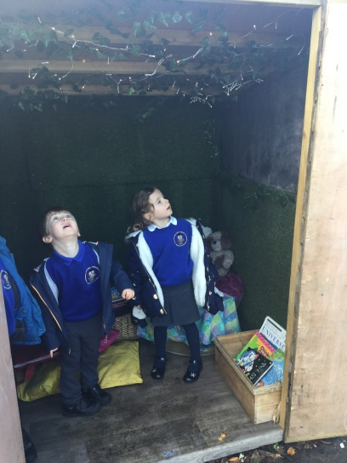
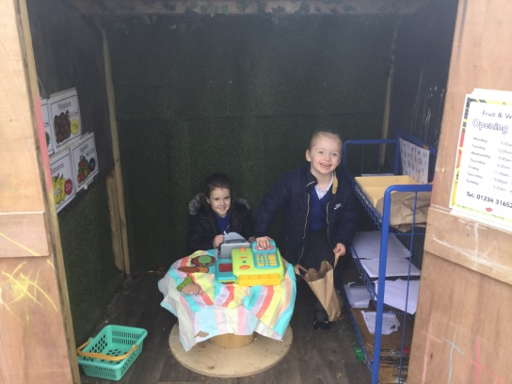
The learning environment – Outside learning environment
Equipment to support gross motor development
Opportunities to develop fine motor control using natural objects
Maths role play area
Construction
Mark making/writing shed
Storytelling shed
Mark making/writing area

Slide 10
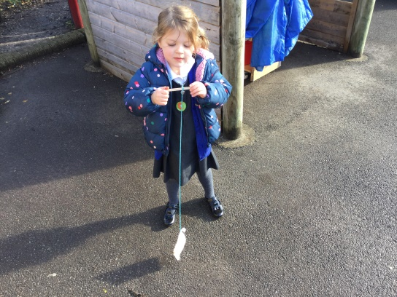
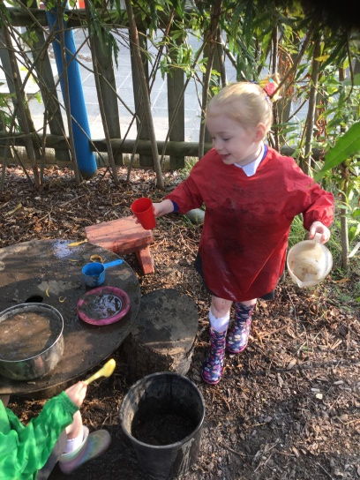
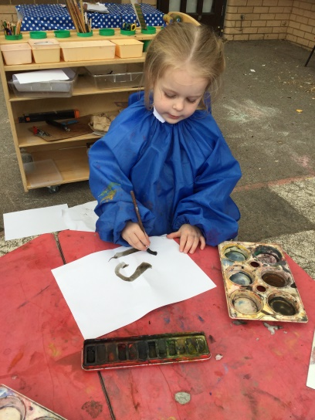
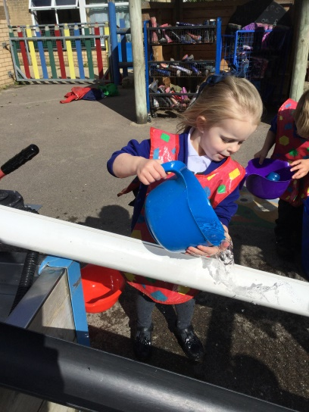
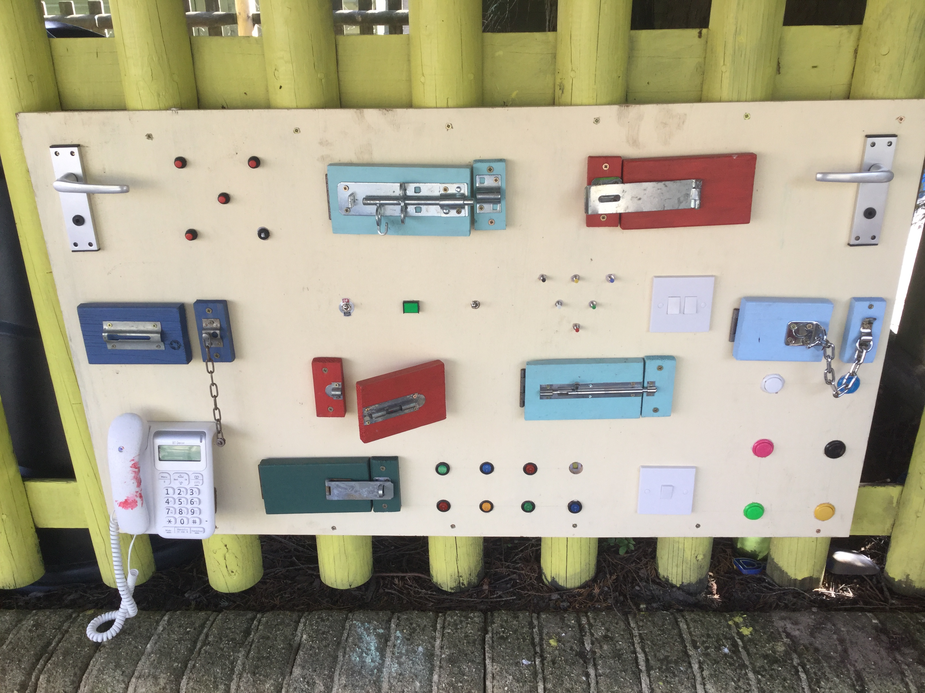
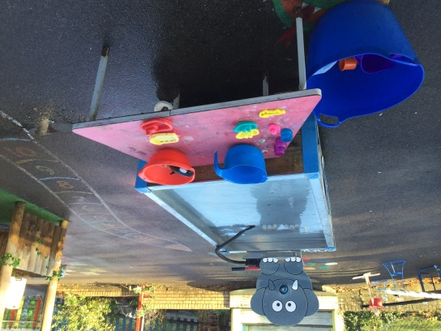
The learning environment – Outside learning environment
Using creative resources to follow own interests
Mud kitchen
Art cafe
Water play
Equipment to support fine motor development

Slide 11
A typical day in Reception
Morning activity
Children start their day by putting away their belongings and completing a morning activity. Here are some examples of the types of activities children complete for their morning activity
Name and letter writing practise
Sharing books and voting for which story to read that day
Developing fine motor control by threading and using tweezers
Developing an awareness of numbers by counting and matching numerals to amounts
Morning carpet time
During our carpet time sessions we incorporate daily opportunities to develop maths and literacy skills by completing the calendar, self-registration and planning the day’s learning.

Slide 12
A typical day in Reception.. continued
Phonics
At The Willows we follow the Letters and Sounds phonics teaching programme. Children have daily phonics sessions where they learn to match sounds to letters, segment words for writing/spelling and blend sounds together for reading.
Literacy
Everyday the children have a literacy session. The literacy session starts with a whole class input before children complete an activity. We make literacy activities engaging by linking them to a story, our topic or to children’s own interests.
Maths
Children will also take part in a daily maths session. During this session we will build on children’s growing sense of number. Children will sing counting songs, develop 1:1 correspondence, play number games and develop their understanding of simple calculations (adding and subtracting) through a variety of kinaesthetic learning opportunities.

Slide 13
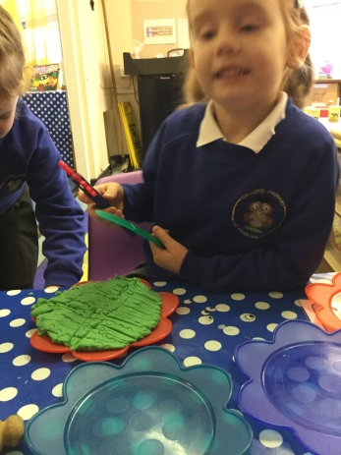
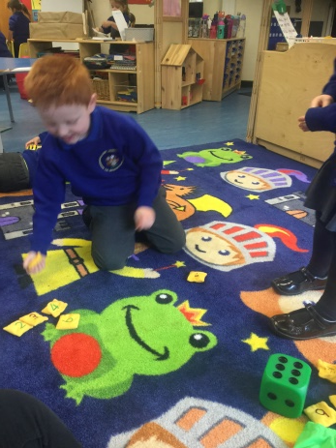
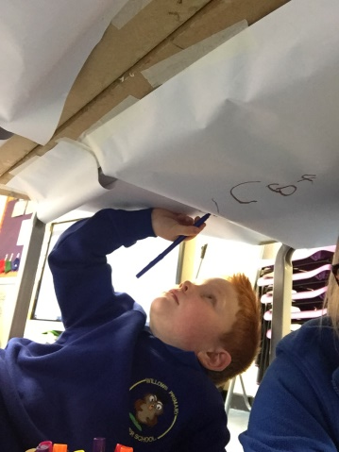
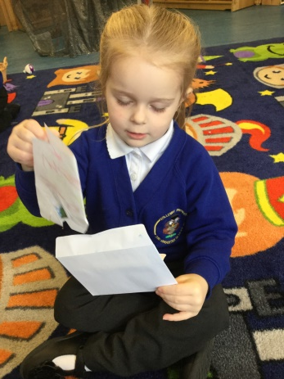
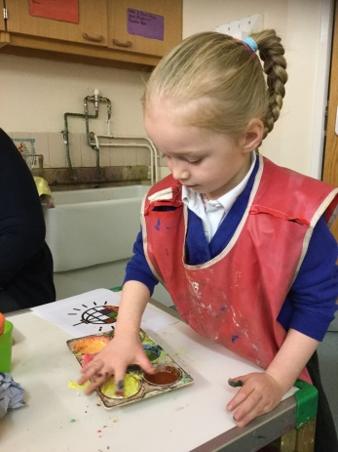
A typical day in Reception
Snack time
Children sit together to share a snack of fruit or vegetable. During snack time children enjoy listening to a story or looking at the independent learning choosing board.
Independent learning
The children can choose where and how they spend their independent learning time. The children are encouraged to choose activities from the choosing board as well as follow their own interests. The activities on the choosing board are linked to the adult directed activities the children have completed in maths, literacy and phonics, so that children can consolidate their learning and continue to develop their knowledge and understanding. The environment is set out to support learning across all areas of the Early Years curriculum. During independent learning time children can help themselves to milk at the snack table.

Slide 14
A typical day in Reception
Independent learning review time
Children are encouraged to share with each other how they have spent their independent learning time. Children are taught and supported to use the language of learning when talking about learning they have undertaken during independent learning time.
Lunch time
Children can choose to have either a packed lunch or a school dinner.
Making muscles
Everyday children have a making muscles session. These sessions are focused on developing children’s gross and fine motor control. Here are some examples of making muscles activities.
Dough gym
Scissor control practise
Following patterns
Write dance
Maths
Children have daily mathematic sessions to support their development with number and space, shape and measure.
Independent learning
Children finish their school day with an afternoon independent learning session.

Slide 15
Home school link
Stay and play sessions
Throughout the year, parents are invited to ‘Stay and Play’ sessions. These will focus on a variety of topics and will help you to support your child’s learning and development.
Seesaw
We use a program called Seesaw to share helpful videos and messages with parents. Parents can use Seesaw to upload children’s WOW stars (for those WOW moments at home e.g. being helpful at home, sharing and being kind with siblings) and learning gems (for those times when children have learnt a new skill, such as riding a bike, or getting a certificate). At school, we encourage children to use the Seesaw app to record the learning they have undertaken during their independent learning time.
Learning stories
At various points in the year, you will receive learning stories, which have been written about your child. A Learning Story is a story that tells a tale to those who are reading it. It shows the decisions children have made and the outcomes that follow.
Parents evening
You will be invited to meet with your child’s teacher at parent’s evening to discuss how they have settled into school life and to discuss your child’s learning and development.

Slide 16
Other information
PE
Once a week children have a PE session. PE in Reception is led by a qualified PE teacher.
ECAT
At the Willows we use a programme called ECAT (Every child a talker) to support staff in raising children’s attainment with communication and language skills.
Makaton
We are committed to ensuring that all children are able to communicate their needs, wants and interests with their peers and the adults who support them in the Reception unit. Children in the Foundation stage are taught makaton symbols and signs. Makaton supports the development of essential communication skills such as attention and listening, comprehension, memory, recall and organisation of language and expression.

