Slide 1

PROSPECTUS 2022/23
Pyle Hill, Greenham, Newbury,
Berkshire, RG14 7SJ
Tel: 01635 42155
office@willows.w-berks.sch.uk
Notes:
Title in Calibri – size 28

Slide 2
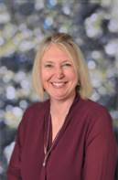
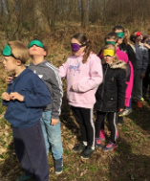
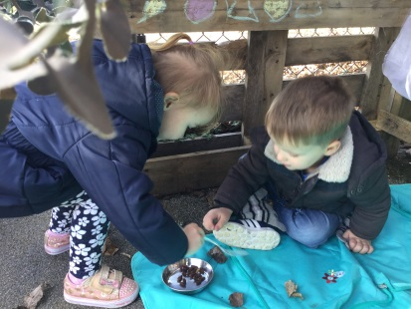
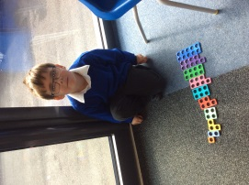
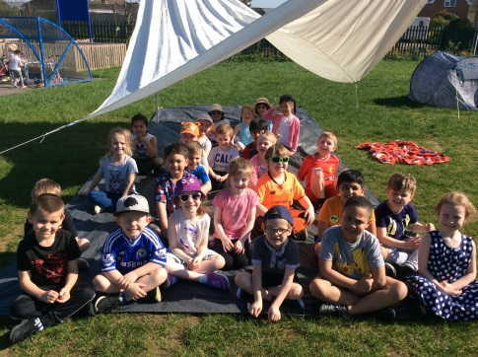
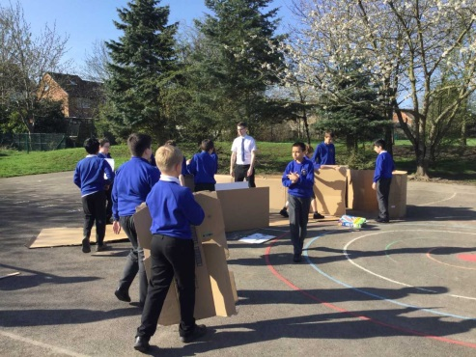
Welcome
Dear Prospective Parents, Pupils and Visitors,
Thank you for taking the time to visit The Willows Primary School – we hope that we offered you a warm welcome.
Unhappy children fail to thrive and it is our intention to make all children feel secure and happy here at The Willows. We want to give all children confidence in themselves and their abilities as this provides a strong foundation on which to develop a range of literacy and numeracy skills, equipping them with the necessary knowledge and understanding in order to be successful as they move through secondary education and into adult life.
Our school is a very happy, vibrant and busy place. Our pupils enjoy coming to school and benefit greatly from the many exciting learning opportunities they are given. The dedicated staff team places a strong emphasis on creating a safe, well resourced and attractive environment in which all children can learn.
The Willows Primary School is a family-orientated school and encourages parents, family members and volunteers from the local community to support learning in all areas of the
curriculum and school events.
I hope some of the information here will help to confirm whether our school is the right environment for your child. However, if you still have unanswered questions please just get in touch and a member of my team or I will happily answer them.
Yours sincerely,
Miss MacArthur (Headteacher)
Notes:
Title in Calibri 32, sub title in Calibri 17, text in Calibri 10

Slide 3
Staff At The Willows
Miss MacArthur – Headteacher Mr Steer – Deputy Head & SENCO
Mrs Faithfull – Pastoral Support Worker & ELSA Miss McGoey – ELSA
EYFS Team
Teachers
Miss Waldeck – Reception Lead
Miss Bremner – Reception teacher
Miss Edwards - ReceptionTeacher
Mrs Case – EYFS teacher
Mrs Hewitt – Nursery Teacher
Mrs Smith – Nursery Nurse
Support Staff
Mrs Littlefield
Mrs Tonge
Mrs Stubbs
Mrs Foulds
Mrs Callender
Mrs McIntyre
Miss Petch
Miss Johnson
KS1 Team
Teachers
Mrs Jackson – Assistant Head & Teacher
Mrs Tillett – Teacher
Mrs Whitmee – Teacher
Mrs Dehghan - Teacher
Support Staff
Mrs Reynolds
Mrs Willis
Mrs Salumah
Mrs Burton
Mrs Radford
UKS2 Team
Teachers
Mr Jezzard –Team Leader & Teacher
Ms Sawyer – Teacher
Mrs Perrin – Teacher
Mrs Clarkson - Teacher
Mr Jordan - Teacher
Support Staff
Mrs Marsh
Mrs Griffin
Mrs Woodcock
Mr Turner
Mr Reeves
Mrs Chad
Mr Fisher
Miss MacLennan
LKS2 Team
Teachers
Miss Wigley – Team Leader & Teacher
Miss Sinclair – Teacher
Miss Collins – Teacher
Mr Banks - Teacher
Support Staff
Mrs Moffatt
Mrs Dale
Miss Duggan
Mrs Meikle
Mrs Bunney
Mr Moreton
Office Staff
Mrs Enefer – School Business Manager
Mrs Hargreaves – Office
Caretaker Sports Leader
Mr Chaundy Mr Turner
Class Structure
EYFS
Saplings 2/3 year olds
Nursery 3/4 year olds
Reception Classes
Ash
Elm
KS1
Y1 Class
Beech
Y2 Classes
Yew
Pine
LKS2
Y3 Classes
Cedar
Redwood
Y4 Classes
Maple
Walnut
UKS2
Y5 Classes
Cypress
Sycamore
Y6 Classes
Eucalyptus
Acacia
Notes:
Title in Calibri 32, sub title in Calibri 17, text in Calibri 10

Slide 4
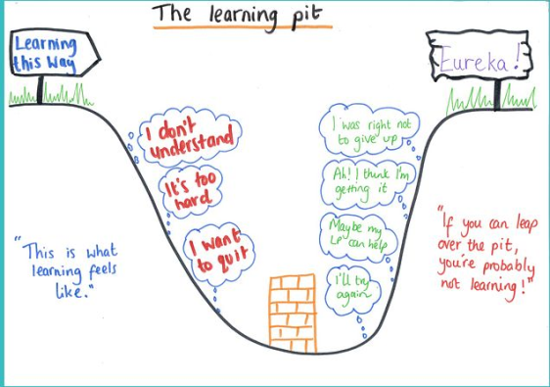





Learning at The Willows
At our school we strive to ensure that pupils not only become great learners but also responsible and active citizens.
Children are taught that learning is a journey and that there are steps that we can all take to understand our own learning in order to make progress on that journey. In the Early Years Foundation Stage, children are introduced to learning buddies who each display a characteristic of learning. Cliff the Concentrating Chameleon, for example, works hard to sustain his thinking whilst Marty the magic mole has a creative flair and approaches challenges in different ways.
From Year 1 to 6 pupils are taught about ‘The Learning
Pit’. The pit represents the difficulties we encounter
on our learning journey and is talked about in terms of
how we feel and what we might be faced with at
different stages of learning. Often during learning we
all go through a stage of struggling and this is what we
call, ‘being in the pit’. Through perseverance,
overcoming mistakes and facing challenges
and misconceptions we are able to climb out of the pit
and feel proud of achieving new learning!
Alongside the learning pit we have adopted the 5Bs strategy to help all pupils take a greater degree of responsibility in their own learning. The 5Bs give children strategies to help themselves and ways to access support when they are stuck or in the pit.
The 5Bs are:
Notes:
Title in Calibri 32, sub title in Calibri 17, text in Calibri 10

Slide 5

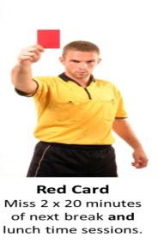
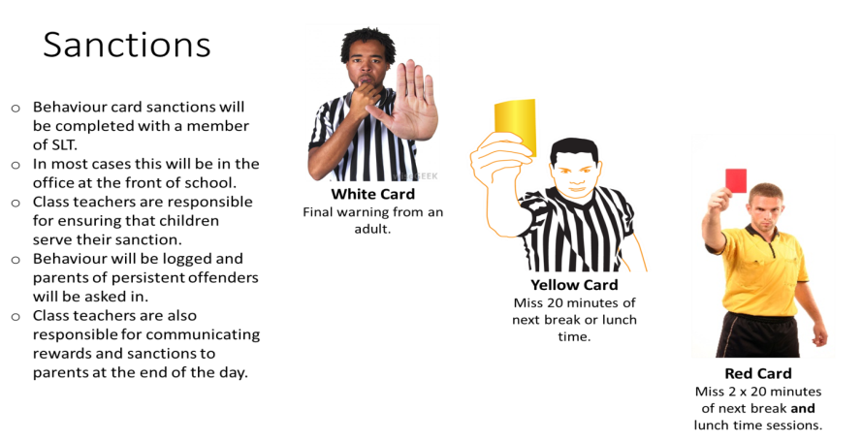


Special Educational Needs and Disabilities (SEND)
All pupils at The Willows have the right to access broad, balanced and challenging learning opportunities and as such all pupils are included in all aspects of school life.
At some point during their time at The Willows any child could have a special educational need whether it is temporary or more permanent. The term Special Educational Need refers to a wide range of learning, social and emotional or physical difficulties that may have an impact on the child’s learning ability or ability to access the curriculum.
We keep a Special Educational Needs and Disabilities (SEND) register of children who need support which is ‘additional to and different from’ the majority of pupils in school. Children on the SEND register may have a Success and Achievement Plan (SAP) with personalised targets.
Mr Steer is the Deputy Head and also works as the SENCO at our school. He can be contacted via the school office.
You can find out more about our SEND provision by reading our ‘Local Offer’. This can be found on our website www.thewillowsprimary.org
Behaviour – Rewards & Sanctions
We have high expectations of behaviour and learning at The Willows. This is underpinned through good communication with children, parents and school staff.
Our school rules have been created with our children and aim to ensure children become good citizens and good learners.
At the Willows we will:
Be Kind
Be Respectful and Honest
Be Polite
Be Safe
In our learning we will:
Persevere
Do our best
Support each other to learn
Allow the teachers to teach
Where behaviour and learning is good or outstanding, rewards are given. Rewards vary from verbal praise to house points, praise certificates to displaying of work.
Where learning or behaviour falls short of the standard expected, we use a consistent approach of warnings and sanctions to ensure that children know the consequences of poor behaviour and have the opportunity to improve. Our card system underpins all sanctions.
Notes:
Title in Calibri 32, sub title in Calibri 17, text in Calibri 10

Slide 6
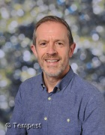
Governors
Our governing board has three core functions. These are to:
1. Ensure clarity of vision, ethos and strategic direction;
2. Hold the Headteacher to account for the educational performance of the school and its pupils;
3. Oversee the financial performance of the school and make sure it’s money is well spent.
Our Governors are all either elected or appointed for a four year term according to our Instrument of Government, which is approved by the Local Authority (West Berkshire), in order to ensure we have a cross section of opinions and experience. We all have the primary aim of providing an outstanding education to the children of The Willows.
The full Governing body has 10 members. Our instrument of governance states these should consist of:
Two parent governors
One Local Authority governor
One staff governor
One head teacher
Five co-opted governors
Chair of Governor’s Welcome
Dear Parents and Carers,
On behalf of the Governors I would like to take this opportunity to welcome you to The Willows Primary School
As a Governing Board we are proud of our children and our warm, nurturing and dynamic school. The Governing Board work hard to support the headteacher, teaching staff and pupils with the aim of ensuring The Willows School is the best it can be.
The role of the Governing Board is to ensure the schools statutory obligations are met in addition to reviewing and monitoring objectives, planning for the future, and to make sure the vision for the school is both challenging and realistic. It is the responsibility of the headteacher to run the school, however, it is the role of the Governing Board to support and strengthen the headteacher’s leadership, and to hold her accountable for the performance of children and staff.
All our Governors bring with them a range of different skills and experiences to enhance the leadership and management of the school within a great community. Decisions are taken by the whole Governing Board which meets once a month and these follow a meetings schedule to consider the more specific areas of staffing, curriculum and finance.
We feel extremely privileged to be part of the life of our successful and vibrant school and appreciate the active and enthusiastic role Willows parents play, both in the development and growth of the children, and through the fundraising activities of PTFA.
Huw Griffiths
Chair of Governors
Policies
An important role of the Governing Body is to ensure the robustness of school policies.
A full list of our statutory policies including Safeguarding, Behaviour & our Equality Statement can be found on the school website www.thewillowsprimary.org.
You can also find some of our non-statutory policies including our curriculum statement and calculation policy on this page.
Notes:
Title in Calibri 32, sub title in Calibri 17, text in Calibri 10

Slide 7








Safeguarding
Safeguarding is of the utmost importance to us at The Willows Primary School. All staff receive Universal Safeguarding Training as soon as they start working at the school and we have 4 Designated Safeguarding Leads who have had additional safeguarding training.
Through assemblies, RSHE and ICT lessons we strive to teach the children how to safeguard themselves online and in the wider world.
Our pastoral team
Mrs Faithfull
Miss McGoey
Mrs Marsh
We teach our children who they can talk to if they are worried or upset.
Teaching assistants
Other adults who work in school
Class teachers
A family member
Miss MacArthur or Mr Steer

Slide 8
Breakfast & After School Club
Breakfast Club
Our current breakfast club is rapidly growing and we are looking forward to welcoming more children for a healthy start to the day. Doors open at 8:00 for breakfast club with sessions costing £3.50 for one child or £3.00 each when siblings attend the same sessions. We are able to accept childcare vouchers using the URN 135213.
Children have a range of cereal options along with the usual toasts, spreads and drinks. If your child has any intolerances we are able to make appropriate substitutions so please do let us know if this is the case. Booking can be made at Reception or via the form below. Payment must be received before children can attend breakfast club.
After School Club
Our after-school club is run by Natasha along with a range of different support staff from the school. ASC have their own dedicated space within The Nest and children are collected from their classes each evening after school before heading over to this space. ASC runs from 3:10 - 5:30pm.
Sessions cost £7.75 per pupil with a discounted price of £6.75 when siblings are attending the same session (late pick-up fees apply). A snack and drink is included within the price of this session so please do ensure that your child's dietary needs are up to date.
Children need to be collected from ASC via The Nest gate on The Nightingales road instead of using school reception. There is a doorbell for this building The ASC have recently been furnished with lots of comfortable furniture and children have lots of opportunities for relaxing and playing after a long day at school.
Notes:
Title in Calibri 32, sub title in Calibri 17, text in Calibri 10

Slide 9
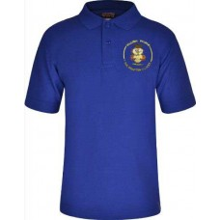
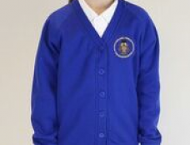
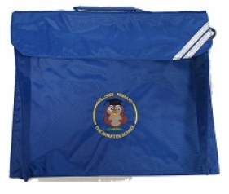
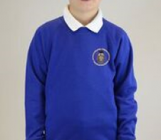


Uniform
The Willows school uniform is:
White shirt/blouse or blue/white polo shirt
Blue Willows sweatshirt with logo
Grey/black skirt, trousers or pinafore
White, black or grey socks or black, blue, grey tights.
Smart black shoes (no flip flops, boots, trainers, and no shoes with high heels permitted)
*For the summer term blue checked dresses and grey/black school shorts are suitable alternatives to normal dresses and trousers.
The Willows PE kit is:
Blue T-shirt (logo optional)
Black shorts
Plimsolls or trainers
Black, grey or blue track suit for cold weather
P.E kit bag
ALL UNIFORM AND PE KIT MUST BE NAMED
Lunches
School Dinner
Children can have a hot meal every day prepared freshly in our school kitchen by Dolce.
Children have 3 meal choices including a vegetarian option for £2.30 a day. Payments can be made online at
www.schoolgrid.co.uk/
Menus are sent out in advance and choices can be made by parents at home or by pupils in school.
Reception and KS1 are entitled to a free school meal everyday.
Packed Lunch
Alternatively children can bring a packed lunch each day.
As we have a number of children with severe allergies we kindly ask you not to send children in with nuts in their lunch boxes this include peanut butter and chocolate spread.
Snack & Water
We know that it can be a long time from breakfast to lunch and ask that children in KS2 bring a healthy snack for morning break time. All children in KS1 and the Early Years have access to a choice of fruit everyday so an additional snack is not required.
Please also send in a named water bottle with your child so that they can stay hydrated throughout the day. This must only contain water.
Notes:
Title in Calibri 32, sub title in Calibri 17, text in Calibri 10

Slide 10
Other Useful information
Charging & Remissions.
To enhance our curriculum we offer a variety of trips and experiences throughout the year.
Some of these may be chargeable.
More information on charging and remissions can be found on the Policies page within the school website.
Term Time Holidays
Attendance at school is crucial to ensuring that gaps in learning do not appear. Term time holidays are not authorised and parents can be fined for withdrawing pupils for a term time holiday.
For more information see the Attendance policy on the school website.
The School Day
Nursery & Saplings school hours are:
Mon – Fri 8:35 – 3:10 (all day)
Mon – Fri 8.35am – 11.35am (mornings)
Mon – Fri 12.10pm – 3.10pm (afternoons)
Reception to Y6 school hours are:
Mon – Fri 8:35 – 3:10
Extra Curricular Clubs
Throughout the year, we offer a range of sports and after school clubs. These are run by our sports coaches and class teachers.
A club letter is sent at the start of each term. Children can sign up for one club per term.
PTFA
The Willows is lucky to have an active PTFA. The PTFA has raised thousands of pounds for the school through cake sales, fetes, discos and movie nights (amongst other things!)
Meetings are usually held every month. Please see information on the PTFA page of the website.
Homework
All children are expected to read or be read to at home. Each Key Stage sets some form of homework each term and this depends on the age and developmental stage of their pupils.
Our homework policy can be found on the Policies page of the school website.
Notes:
Title in Calibri 32, sub title in Calibri 17, text in Calibri 10

