Slide 1

PROSPECTUS 2025/26
Pyle Hill, Greenham, Newbury,
Berkshire, RG14 7SJ
Tel: 01635 42155
office@willows.w-berks.sch.uk
Notes:
Title in Calibri – size 28

Slide 2
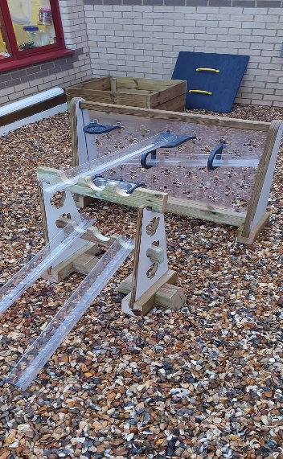
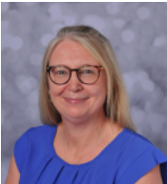
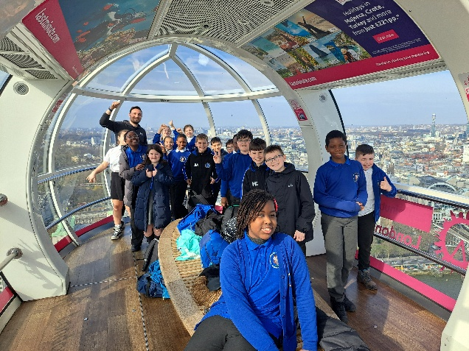
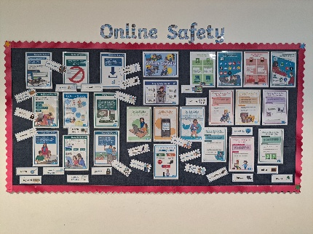
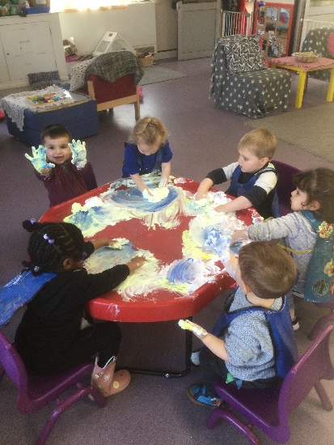
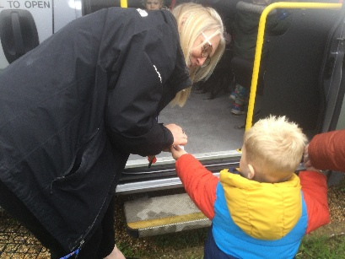
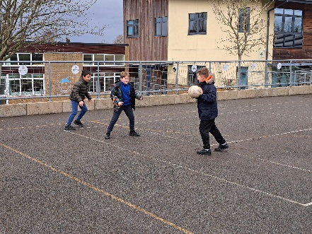
Welcome
Dear Prospective Parents, Pupils and Visitors,
Welcome to The Willows Primary School.
Happy children thrive and it is our intention to make all children feel secure and happy here at The Willows. We want to give all our children confidence in themselves and their abilities as this provides a strong foundation on which to develop a range of literacy and numeracy skills, equipping them with the necessary knowledge and understanding in order to be successful as they move through secondary education and into adult life.
Our school is a very happy, vibrant and busy place. Our pupils enjoy coming to school and benefit greatly from the many exciting learning opportunities they are given. The dedicated staff team places a strong emphasis on creating a safe, well resourced and attractive environment in which all children can learn.
The Willows Primary School is a family-orientated school and encourages parents, family members and volunteers from the local community to support learning in all areas of the
curriculum and school events.
I hope some of the information here will help you to decide whether our school is the right environment for your child. However, if you still have unanswered questions please just get in touch and we will happily answer them.
Yours sincerely,
Miss MacArthur (Headteacher)
Notes:
Title in Calibri 32, sub title in Calibri 17, text in Calibri 10

Slide 3
Testimonials, Thanks and Praise
May we take this opportunity to thank you and the staff at The Willows for all of the work that you do with the children around taking responsibility for respecting and caring for the environment, which is something that my child certainly takes very seriously - I'm delighted that as a result of her learning at The Willows, at age 6 she is coming home and initiating discussions about caring for the world around her with her family and friends and talking about what we can do to help. (Parent)
We really appreciate the approach at The Willows to push children to achieve without stressing or even letting them realise. (Parent)
I would like to take this opportunity to thank you for all the hard work and great effort you have made to make this school safe for our children. I really appreciate it. (Parent)
On Friday morning last week I was riding my bike down Pyle hill on the cycle pavement , a boy from your school was pushing his bike up the hill. When he saw me cycling towards him, he stopped moved over to the side of the path and waited , as I passed him I said thank you . In a bright cheerful voice he said you're welcome . I was so impressed I felt I had to write to you - he is a credit to his school and his parents. Thank you again. (Member of the public)
I wanted to extend my thanks to yourself and your school community for being such a welcoming school. Every teacher I observed was enthusiastic and delivered such brilliant practice for me to reflect upon. You should be (and are as I can see from the lovely Praise Assemblies) so proud of the students. The children were lovely, mannered, well rounded, independent learners and I was astounded by the attitude across the whole school. I can see how hard you have all worked to ensure stable routines and feedback and how imperative this is to help the students thrive. I really had a lovely time and hope to pop in to see you all again soon. (PGCE Student)
I wanted to write to you to let you know just how impressed we were with your classes when they visited us last week. I met them on arrival, and they were excited but also exceptionally well behaved. During their self-guided visit and was impressed by their interest, enthusiasm and behaviour. They were polite friendly and intrigued by the things I showed them. We work with many schools and I felt I had to write to tell you that your classes did you proud and you are one of our best school groups ever. Clare Coleman, Education Officer - Ashmolean Museum of Art and Archaeology
Notes:
Title in Calibri 32, sub title in Calibri 17, text in Calibri 10

Slide 4
Testimonials, Thanks and Praise
My child was so excited and full of wonderful stories after his amazing trip to Didcot Train Station yesterday. Thank you so much for organising and providing these wonderful experiences away for the children. (Parent)
Please could you pass on our thanks to the school and the staff that were on the Y6 residential trip. My child has just spent an hour telling me all about it. She had an excellent time and was full of it. She enjoyed every minute of it and didn't want to come home. Thank you so much to all involved, I'm sure this trip will stand out in their memories for a long time. Your efforts are really appreciated. (Parent)
The Christmas Gift at The Willows is always a highlight. This year though, I do want to congratulate you on your Y6 students - they were so wonderful to work with. Their thoughtfulness, attitude to giving it all a go and their behaviour for learning was without doubt, exceptional. We have been working with many primary schools in the Newbury area this season, and The Willows this year, was outstanding. Organiser of the COINS project.
I visited a child in your nursery class this morning. I wanted to feedback on the amazing interactions between the staff team and the children that I observed during my visit. The adults were down at the level of the children, following the children’s lead, and using lots of strategies to support the development of speech, language, and communication skills. The children were all engaged in activities and it was a lovely calm environment. I rarely observe this when I visit early years settings and it was a pleasure to see such wonderful support in action this morning. Please thank your staff team for all they do.
I’m emailing to say thank you so much for hosting the football matches on Monday and for the very warm welcome my school received. My sports coach, came back full of compliments about what a friendly and welcoming school the Willows is and what a lovely calm environment you and your team have created. She really enjoyed her time at The Willows.
Dear all staff at The Willows, I just wanted to send an email to thank each and everyone of you for the help and guidance my child has been given on his journey though primary school. I wish you all the very best for the future. (Parent)
Notes:
Title in Calibri 32, sub title in Calibri 17, text in Calibri 10

Slide 5
Staff At The Willows
Miss MacArthur – Headteacher, DSL Mr Jezzard – Deputy Head, Deputy DSL
Mr Waller – SENCO Mrs Marsh – ELSA and Pastoral Support
Miss McGoey – ELSA and Pastoral Support Mrs Woodcock – ELSA
KS1 Team
Teachers
Mrs Jackson – Assistant Head &Y2 Teacher
Miss Waldeck – Y1 Teacher
Mrs Radford – Y1 Teacher
Mrs Whitmee – Y2 Teacher
Mrs Millington – Y2 Teacher
EYFS Team
Teachers
Miss Beacham – Reception teacher
Mrs Littlefield – Reception Teacher
Mrs Case – EYFS teacher
Mrs Hewitt – Nursery Teacher
Mrs Smith – Nursery Nurse
UKS2 Team
Teachers
Mr Jezzard –Team Leader & Y6 Teacher
Ms Sawyer – Y6 Teacher
Mr Jordan – Y5 Teacher
Mrs Clarkson - Y5 Teacher
Miss Slatter – Y5 Teacher
LKS2 Team
Teachers
Miss Wigley – Team Leader & Y3/4 Teacher
Miss Sinclair – Y3/44 Teacher
Mr Banks - Y3/4 Teacher
Office Staff
Mrs Enefer – School Business Manager
Mrs Hargreaves – Office
Mrs Chad - Office
Caretaker Sports Leader
Mr Chaundy Mr Turner
Class Structure
EYFS
Saplings 2/3 yr olds
Nursery 3/4 yr olds
Reception Classes
Ash
Elm
KS1
Y1 Classes
Beech
Acacia
Y2 Class
Yew
Pine
LKS2
Y3/4 Classes
Maple
Cedar
Walnut
UKS2
Y5 Classes
Cypress
Redwood
Y6 Classes
Eucalyptus
Sycamore
Notes:
Title in Calibri 32, sub title in Calibri 17, text in Calibri 10

Slide 6
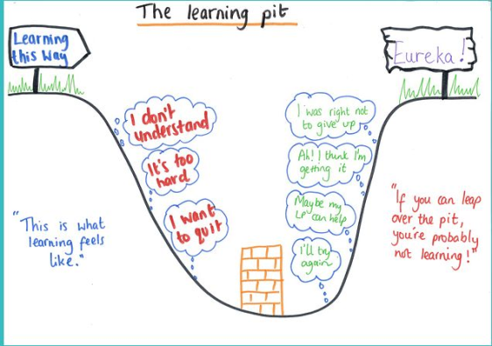





Learning at The Willows
At our school we strive to ensure that pupils not only become great learners but also responsible and active citizens.
Children are taught that learning is a journey and that there are steps that we can all take to understand our own learning in order to make progress on that journey. In the Early Years Foundation Stage, children are introduced to learning buddies who each display a characteristic of learning. Cliff the Concentrating Chameleon, for example, works hard to sustain his thinking whilst Marty the magic mole has a creative flair and approaches challenges in different ways.
From Year 1 to 6 pupils are taught about ‘The Learning
Pit’. The pit represents the difficulties we encounter
on our learning journey and is talked about in terms of
how we feel and what we might be faced with at
different stages of learning. Often during learning we
all go through a stage of struggling and this is what we
call, ‘being in the pit’. Through perseverance,
overcoming mistakes and facing challenges
and misconceptions we are able to climb out of the pit
and feel proud of achieving new learning!
Alongside the learning pit we have adopted the 5Bs strategy to help all pupils take a greater degree of responsibility in their own learning. The 5Bs give children strategies to help themselves and ways to access support when they are stuck or in the pit.
The 5Bs are:
Notes:
Title in Calibri 32, sub title in Calibri 17, text in Calibri 10

Slide 7

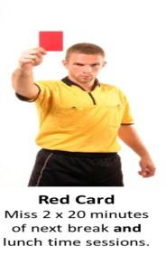
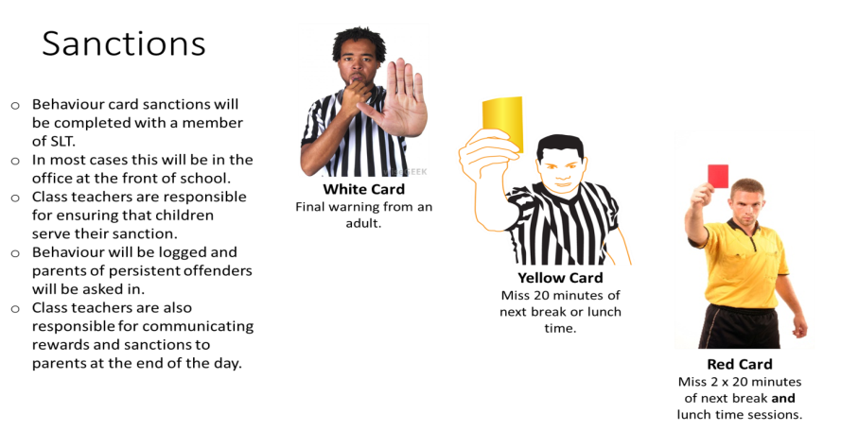


Special Educational Needs and Disabilities (SEND)
All pupils at The Willows have the right to access broad, balanced and challenging learning opportunities and as such all pupils are included in all aspects of school life.
At some point during their time at The Willows any child could have a special educational need whether it is temporary or more permanent. The term Special Educational Need refers to a wide range of learning, social and emotional or physical difficulties that may have an impact on the child’s learning ability or ability to access the curriculum.
We keep a Special Educational Needs and Disabilities (SEND) register of children who need support which is ‘additional to and different from’ the majority of pupils in school. Children on the SEND register may have a Success and Achievement Plan (SAP) with personalised targets.
You can find out more about our SEND provision by reading our ‘Local Offer’. This can be found on our website www.thewillowsprimary.org
Behaviour – Rewards & Sanctions
We have high expectations of behaviour and learning at The Willows. This is underpinned through good communication with children, parents and school staff.
Our school rules have been created with our children and aim to ensure children become good citizens and good learners.
At the Willows we will:
Be Kind
Be Respectful and Honest
Be Polite
Be Safe
In our learning we will:
Persevere
Do our best
Support each other to learn
Allow the teachers to teach
Where behaviour and learning is good or outstanding, rewards are given. Rewards vary from verbal praise to house points, praise certificates to displaying of work.
Where learning or behaviour falls short of the standard expected, we use a consistent approach of warnings and sanctions to ensure that children know the consequences of poor behaviour and have the opportunity to improve. Our card system underpins all sanctions.
Notes:
Title in Calibri 32, sub title in Calibri 17, text in Calibri 10

Slide 8
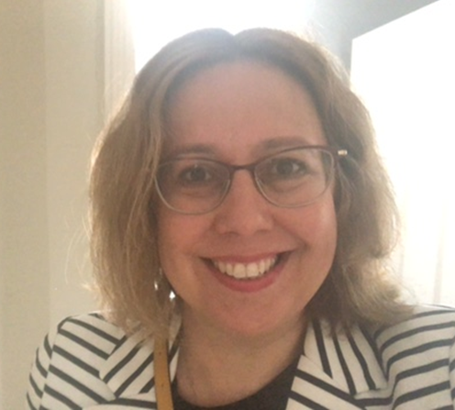
Governors
Our governing board has three core functions. These are to:
1. Ensure clarity of vision, ethos and strategic direction;
2. Hold the Headteacher to account for the educational performance of the school and its pupils;
3. Oversee the financial performance of the school and make sure it’s money is well spent.
Our Governors are all either elected or appointed for a four year term according to our Instrument of Government, which is approved by the Local Authority (West Berkshire), in order to ensure we have a cross section of opinions and experience. We all have the primary aim of providing an outstanding education to the children of The Willows.
The full Governing body has 10 members. Our instrument of governance states these should consist of:
Two parent governors
One Local Authority governor
One staff governor
One head teacher
Five co-opted governors
Chair of Governor’s Welcome
Dear Parents and Carers,
On behalf of the Governors I would like to take this opportunity to welcome you to The Willows Primary School
As a Governing Board we are proud of our children and our warm, nurturing and dynamic school. The Governing Board work hard to support the headteacher, teaching staff and pupils with the aim of ensuring The Willows School is the best it can be.
The role of the Governing Board is to ensure the schools statutory obligations are met in addition to reviewing and monitoring objectives, planning for the future, and to make sure the vision for the school is both challenging and realistic. It is the responsibility of the headteacher to run the school, however, it is the role of the Governing Board to support and strengthen the headteacher’s leadership, and to hold her accountable for the performance of children and staff.
All our Governors bring with them a range of different skills and experiences to enhance the leadership and management of the school within a great community. Decisions are taken by the whole Governing Board which meets once a month and these follow a meetings schedule to consider the more specific areas of staffing, curriculum and finance.
We feel extremely privileged to be part of the life of our successful and vibrant school and appreciate the active and enthusiastic role Willows parents play, both in the development and growth of the children, and through the fundraising activities of PTFA.
Kate Parietti
Chair of Governors
Policies
An important role of the Governing Body is to ensure the robustness of school policies.
A full list of our statutory policies including Safeguarding, Behaviour & our Equality Statement can be found on the school website www.thewillowsprimary.org.
You can also find some of our non-statutory policies including our curriculum statement and calculation policy on this page.
Notes:
Title in Calibri 32, sub title in Calibri 17, text in Calibri 10

Slide 9








Safeguarding
Safeguarding is of the utmost importance to us at The Willows Primary School. All staff receive Universal Safeguarding Training as soon as they start working at the school and we have 4 Designated Safeguarding Leads who have had additional safeguarding training.
Through assemblies, RSHE and ICT lessons we strive to teach the children how to safeguard themselves online and in the wider world.
Our pastoral team
Miss McGoey
Mrs Marsh
We teach our children who they can talk to if they are worried or upset.
Teaching assistants
Other adults who work in school
Class teachers
A family member
Miss MacArthur (Lead)
Mr Jezzard (Deputy)
Mrs Marsh
Miss McGoey
Miss MacArthur or Mr Jezzard

Slide 10





Breakfast & After School Club
Breakfast Club
Our current breakfast club is rapidly growing and we are looking forward to welcoming more children for a healthy start to the day. Doors open at 8:00 for breakfast club with sessions costing £5.00 for one child or £4.00 each when siblings attend the same sessions. We are able to accept childcare vouchers using the URN 135213.
Children have a range of cereal options along with the usual toasts, spreads and drinks. If your child has any intolerances we are able to make appropriate substitutions so please do let us know if this is the case. Bookings can be made at Reception or via the form on the website. Payment must be received before children can attend breakfast club.
After School Club
Our after-school club is run by Mrs Fishlock along with a range of different support staff from the school. ASC have their own dedicated space within The Nest and children are collected from their classes each evening after school before heading over to this space. ASC runs from 3:10 - 5:30pm.
Sessions cost £10.00 per pupil with a discounted price of £8.50 when siblings are attending the same session (late pick-up fees apply). A snack and drink is included within the price of this session so please do ensure that your child's dietary needs are up to date.
Children need to be collected from ASC via The Nest gate on The Nightingales road instead of using school reception. There is a doorbell for this building The ASC have recently been furnished with lots of comfortable furniture and children have lots of opportunities for relaxing and playing after a long day at school.
Notes:
Title in Calibri 32, sub title in Calibri 17, text in Calibri 10

Slide 11
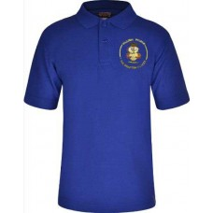
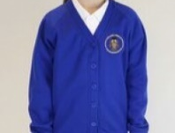
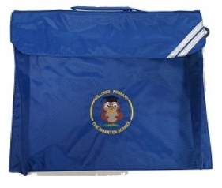
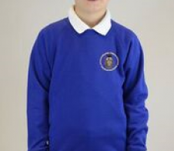


Uniform
The Willows school uniform is:
White shirt/blouse or blue/white polo shirt
Blue Willows sweatshirt with logo
Grey/black skirt, trousers or pinafore
White, black or grey socks or black, blue, grey tights.
Smart black shoes (no flip flops, boots, trainers, and no shoes with high heels permitted)
*For the summer term blue checked dresses and grey/black school shorts are suitable alternatives to normal dresses and trousers.
The Willows PE kit is:
Blue T-shirt (logo optional)
Black shorts
Plimsolls or trainers
Black, grey or blue track suit for cold weather
P.E kit bag
ALL UNIFORM AND PE KIT MUST BE NAMED
For Health and Safety reasons, ONLY stud earrings are permitted and children should be able to tape or remove these themselves for P.E
Lunches
School Dinner
From Reception, children can have a hot meal every day prepared freshly in our school kitchen by Dolce.
Children have 3 meal choices including a vegetarian option for £2.60 a day. Payments can be made online at
www.schoolgrid.co.uk/
Menus are sent out in advance and choices can be made by parents at home or by pupils in school.
Reception and KS1 children are entitled to a free school meal everyday.
Packed Lunch
Alternatively children can bring a packed lunch each day. Nursery children staying for lunch have to bring a packed lunch as hot meals are not available to our Saplings and Nursery classes.
As we have a number of children with severe allergies we kindly ask you not to send children in with nuts in their lunch boxes this include peanut butter and chocolate spread.
Snack & Water
We know that it can be a long time from breakfast to lunch and ask that children in KS2 bring a healthy snack for morning break time. All children in KS1 and the Early Years have access to a choice of fruit everyday so an additional snack is not required.
Please also send in a named water bottle with your child so that they can stay hydrated throughout the day. This must only contain water.
Notes:
Title in Calibri 32, sub title in Calibri 17, text in Calibri 10

Slide 12
Other Useful information
Charging & Remissions.
To enhance our curriculum we offer a variety of trips and experiences throughout the year.
Some of these may be chargeable.
More information on charging and remissions can be found on the Policies page within the school website.
Term Time Holidays
Attendance at school is crucial to ensuring that gaps in learning do not appear. Term time holidays are not authorised and parents can be fined for withdrawing pupils for a term time holiday.
For more information see the Attendance policy on the school website.
The School Day
Nursery & Saplings school hours are:
Mon – Fri 8:35 – 3:10 (all day)
Mon – Fri 8.35am – 11.35am (mornings)
Mon – Fri 12.10pm – 3.10pm (afternoons)
Reception to Y6 school hours are:
Mon – Fri 8:35am – 3:10pm
Extra Curricular Clubs
Throughout the year, we offer a range of sports and after school clubs. These are run by our sports coaches and class teachers.
A club letter is sent at the start of each term. Children can sign up for one club per term.
PTFA
The Willows is lucky to have an active PTFA. The PTFA has raised thousands of pounds for the school through cake sales, fetes, discos and movie nights (amongst other things!)
Meetings are usually held every month.
Homework
All children are expected to read or be read to at home. Each Key Stage sets some form of homework each term and this depends on the age and developmental stage of their pupils.
Our homework policy can be found on the Policies page of the school website.
Notes:
Title in Calibri 32, sub title in Calibri 17, text in Calibri 10

