Slide 1
Test your SPaG with Timmy the Cat

Slide 2
abstract noun
adjective
adverb how
adverb when
adverb where
antonym
article
brackets
collective noun
colon
command
common noun
connective
double negative
ellipse
embedded clause
future tense
grammatically correct
imperative verb
main clause
object
passive
past tense
phrase
plural
prefix
preposition
present tense
pronoun
proper noun
question
semicolon
singular
statement
subject
subject verb agreement
subordinate clause
suffix
synonym
verb

Slide 3
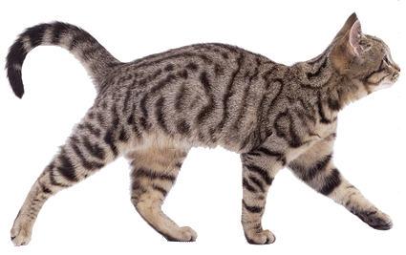
What am I?
common noun
The cat

Slide 4
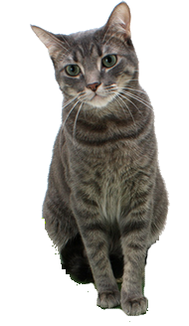
What am I?
proper noun
Timmy sat.

Slide 5
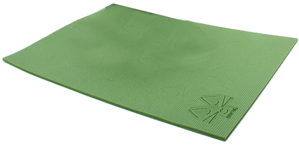
What am I?
common noun
Timmy sat on the mat.

Slide 6
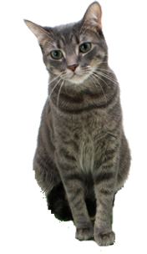
What am I?
collective noun
A clowder of cats sat on the mat.

Slide 7
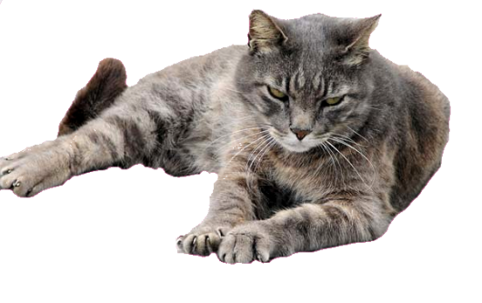
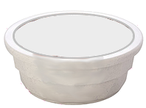
What am I?
abstract noun
The cat felt anger towards the empty bowl.

Slide 8
What is the subject?
cat
The cat sat on the mat.

Slide 9
What is the object?
mat
The cat sat on the mat.

Slide 10
What am I?
verb
The cat sat on the mat.
The cat walked on the mat.

Slide 11
What am I?
verb
The cat is going to walk across the mat.

Slide 12
What am I?
noun
The cat is going for a walk.

Slide 13
What am I?
imperative verb
Walk across the mat.
Sit on the mat.

Slide 14
What am I?
adjective
The friendly cat sat on the green mat.

Slide 15
What am I?
connective
The cat sat on the mat because it was more comfortable.

Slide 16
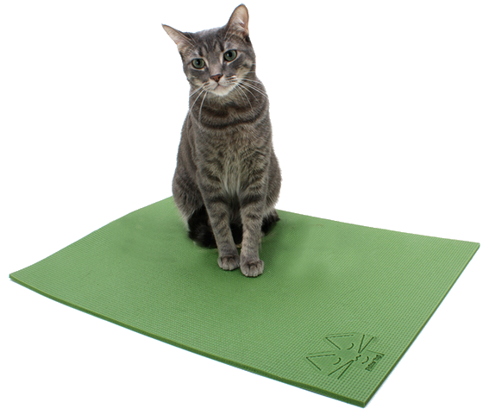
What am I?
pronoun
He sat on his green mat.
They sat on their mat.

Slide 17
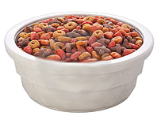
What am I?
adverb how
The cat sat patiently on the green mat.

Slide 18
What am I?
adverb when
The cat sometimes sits on the green mat.

Slide 19
What am I?
adverb where
The cat sat down.

Slide 20
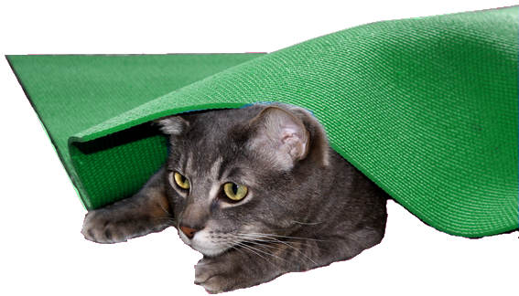
What am I?
preposition
The cat sat in front of the mat.
The cat sat under the mat.

Slide 21
What am I?
article
There is a cat on the mat

Slide 22
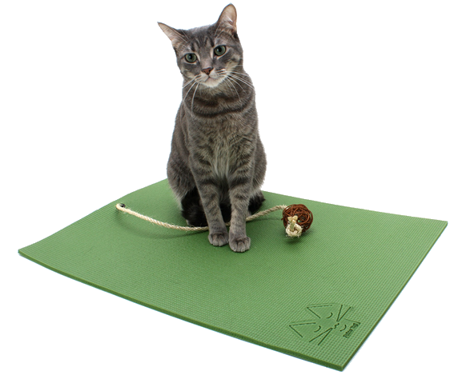
What type of sentence am I?
statement
The cat has run away.
The cat has a toy.

Slide 23
What type of sentence am I?
question
Why is the cat under the mat?
Why is the cat not playing with its toy?

Slide 24
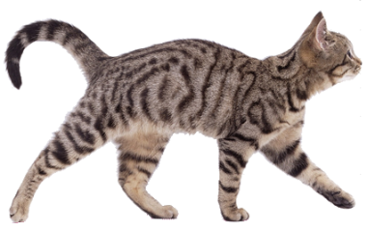
What type of sentence am I?
command
Get off that mat!
Get out from under that mat!

Slide 25
What are all the parts of the sentence called?
Proper
Noun
Common
Noun
Verb
Adverb
Preposition
Article
Adjective
Timmy sat patiently on the green mat.

Slide 26
What am I?
phrase
soft, green mat
running rapidly away
tasty bowl of food

Slide 27
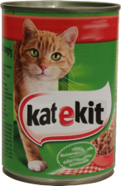
What am I?
main clause
Timmy sat patiently on the green mat as his bowl of food was prepared.

Slide 28
What am I?
subordinate clause
After finishing his bowl of food, Timmy ran off into the garden.

Slide 29
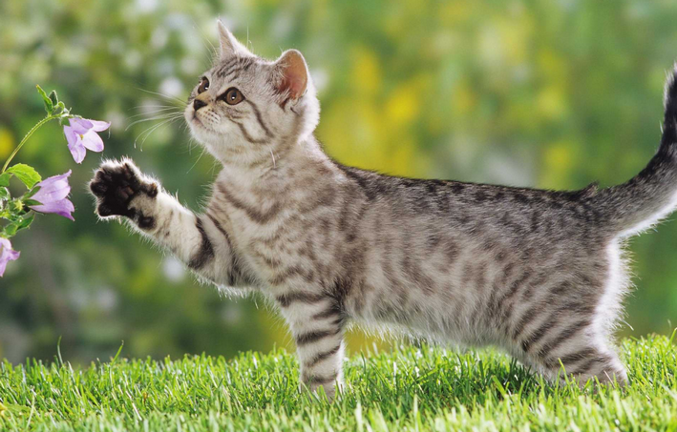
What am I?
embedded clause
Timmy, who was a gentle cat, admired the beautiful flowers in the garden.

Slide 30
What am I?
past
present
future
The cat was sat on the mat but isn’t now.
The cat is sitting on the mat.
The cat is going to sit on the mat.

Slide 31
What am I?
synonym
The cat sat on the mat.
The cat squatted on the rug.
s_non_m

Slide 32
What am I?
antonym
The cat sat on the mat.
The cat stood on the mat.
a_t_n_m

Slide 33
What am I?
prefix
Root Word
The overconfident cat fell off the mat.

Slide 34
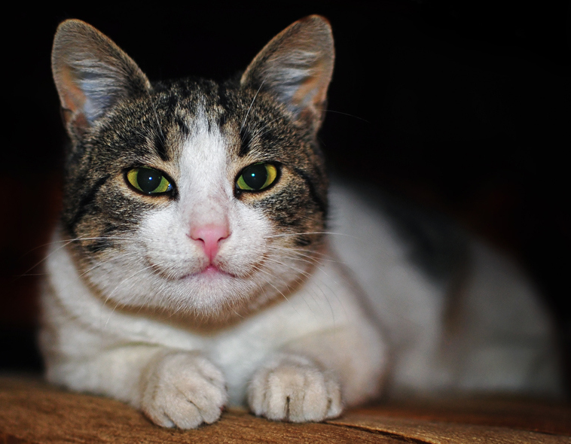
What am I?
suffix
Timmy was a cheerful cat.

Slide 35
What am I?
plural
The cats sat on the mat.

Slide 36
What am I?
singular
There was only one mat for the two cats.

Slide 37
What am I?
possession apostrophe
The cat’s bowl was full of food.

Slide 38
What am I?
omission apostrophe
The cat didn’t have any food.

Slide 39
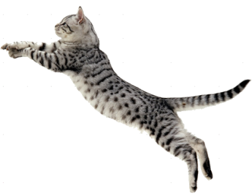
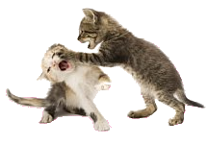
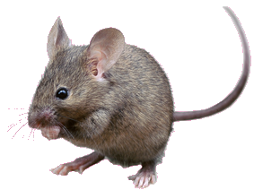
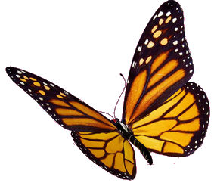
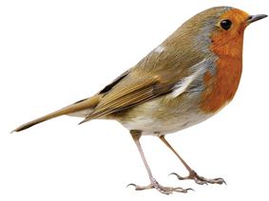
What am I?
commas in lists
Timmy enjoyed jumping, running and fighting.
Timmy ate cat food, birds, mice and insects.

Slide 40
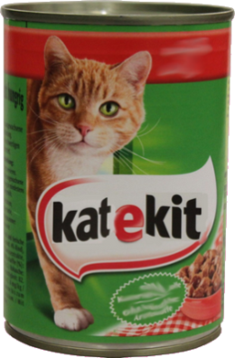
What am I?
brackets (parenthesis)
Timmy likes to eat cat food (KateKit) on weekends.

Slide 41
What am I?
ellipses
The cat knew the mat was somewhere ... but where?

Slide 42
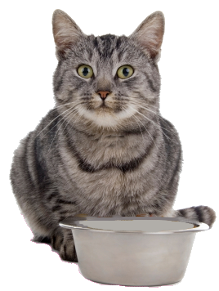
What am I?
semicolon (missing connective)
Timmy went to his bowl; it was empty.

Slide 43
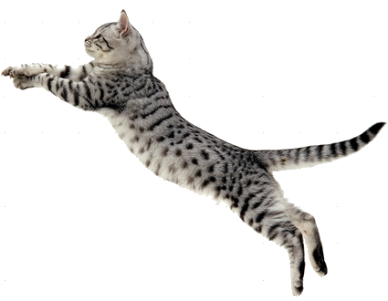
What am I?
semicolons in lists
Timmy enjoyed many activities such as; jumping, running, chasing and fighting.

Slide 44
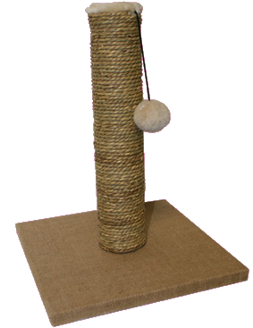
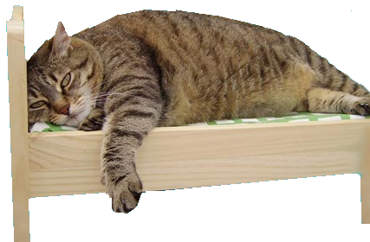
What am I?
colons in lists
Cats need these items to keep them happy: a play mat, a food bowl, a scratching post and a soft basket to sleep in.

Slide 45
What am I?
subject and verb don’t agree
verbs
verbs
The cat were sitting on the mat.
The cats was walking on the mat.
subject
subjects
I agree!

Slide 46
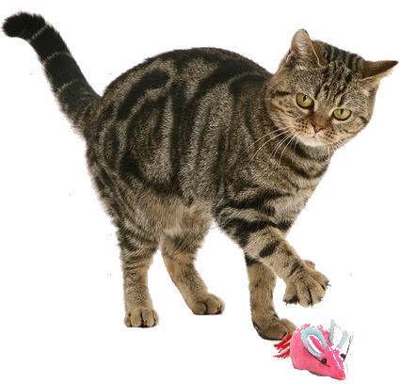
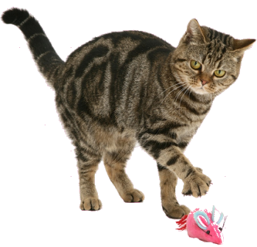
What am I?
not grammatically correct
The cats were playing with there toys.
“Your a lovely cat,” said Ben.
n. g. c.

Slide 47
What am I?
double negative
The cat didn’t have no food.

Slide 48
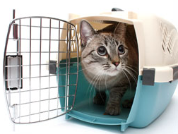
Which is Grammatically Correct?
subject
The cat and I went to the vets.
correct
The cat and me went to the vets.
wrong

Slide 49
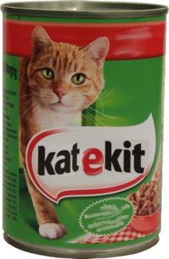
Which is Grammatically Correct?
subject
object
The cat wanted me to give it some food.
correct
The cat wanted I to give it some food.
wrong

Slide 50
What am I?
passive
The mat was sat on by the cat.

